Slide 1
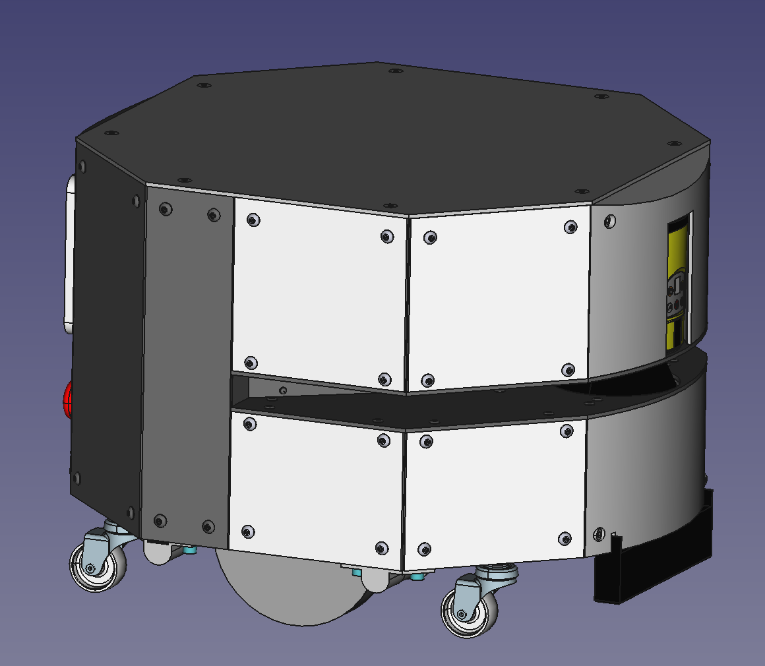
AMR
Assembly - Mechanical

Slide 2
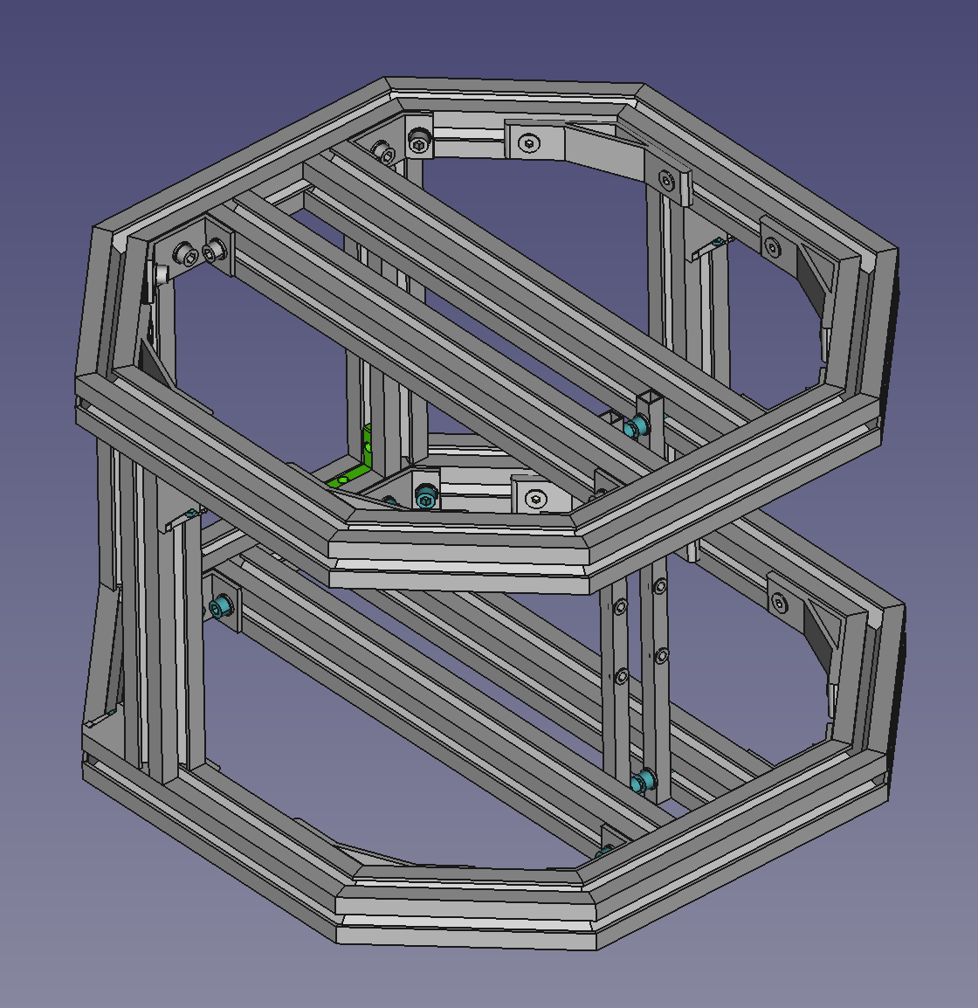
Assembly Part 1. Chassis
-Chassis Top
-Chassis Bottom
-Chassis Middle

Slide 3
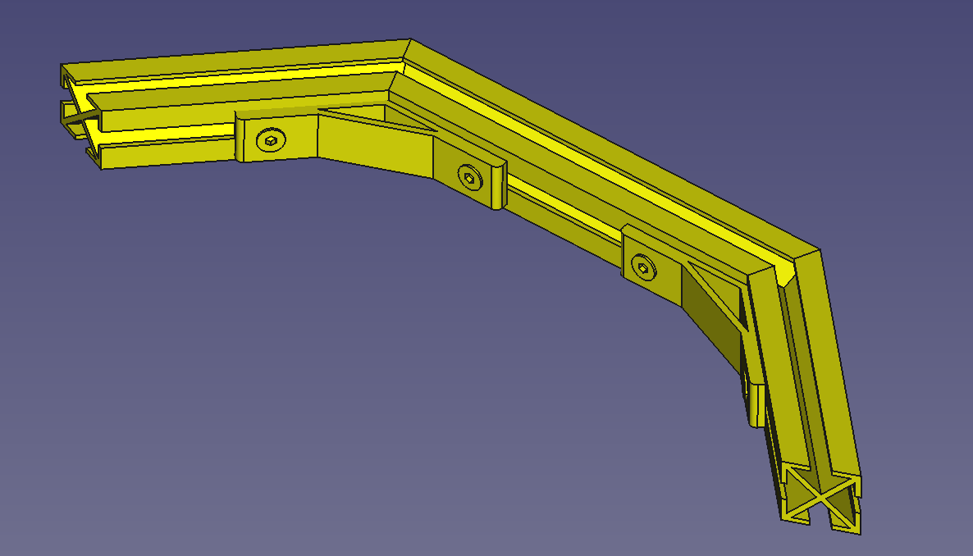
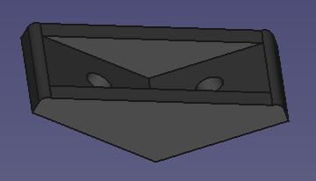
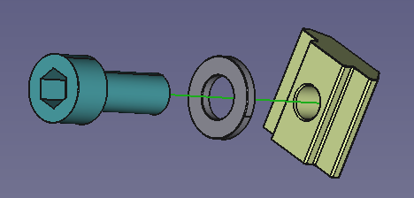
Set A
Number of units to assemble: 2 + 2
Insert 2 x M5 T-Nuts
in ext. groove (cover)
Insert 1 x M6 T-Nut in
top groove (mid chassis)
Insert 2 x M5 T-Nuts in ext. groove (covers)
2 x M5 T-Nuts in top groove (cover)
1
Insert 4 x M5 T-Nuts in
ext. groove (covers)
1
Insert 4 x M5 T-Nuts in ext. groove (covers)
Insert 1 x M6 T-Nut in
bottom groove (mid chassis)
Insert 2 x M6 T-Nut in
bottom groove (axels)
3
3
Insert 1 x M5 T-Nut
in bottom groove (PLC)
2
Insert 1 x M6 T-Nut in
bottom groove (axels)
2
Chassis Top
3
Chassis Bottom
3
1
Insert 1 x M6 T-Nut in
top groove (drive)
1
3D Printed version
3D Printed version
Insert 1 x M6 T-Nut in
bottom groove (axels)
Insert 2 x M5 T-Nuts in ext. groove (covers)
Insert 2 x M5 T-Nuts in ext. groove (cover)
# | Part Num. | Part Name | Notes
1 | P0165 | 30x30 138mm profile 22,5deg cut
2 | P0160 | 30x30 204mm profile 22,5deg cut
3 | P0011 | 135 degree bracket | Use Screw_M6x14_ISO4762 with M6 washers and T-Nuts

Slide 4
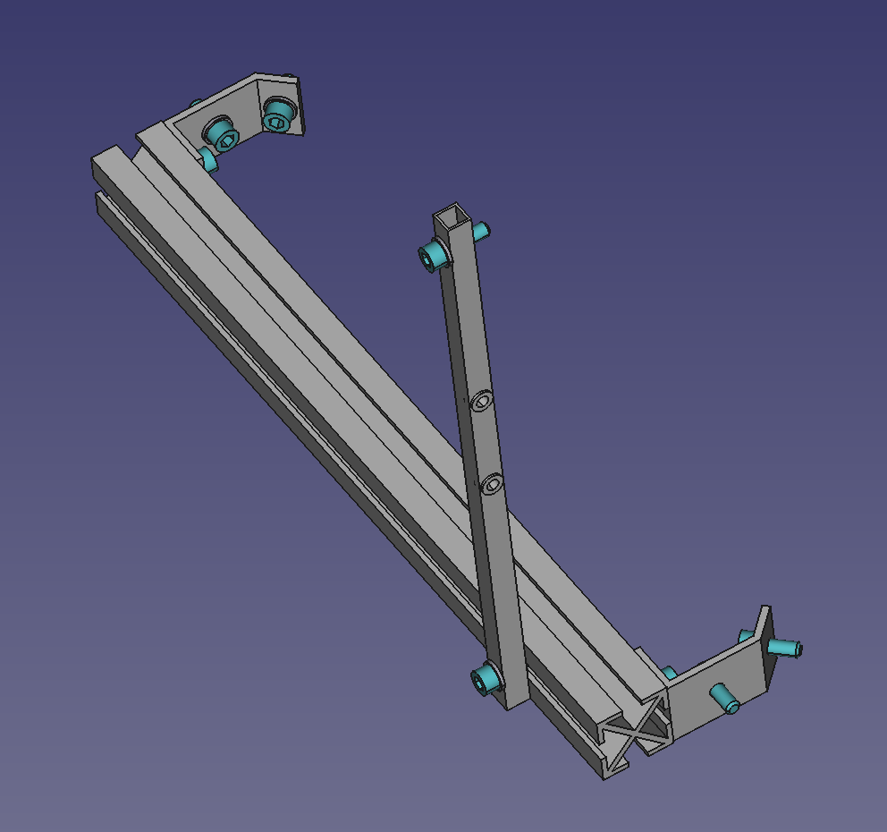
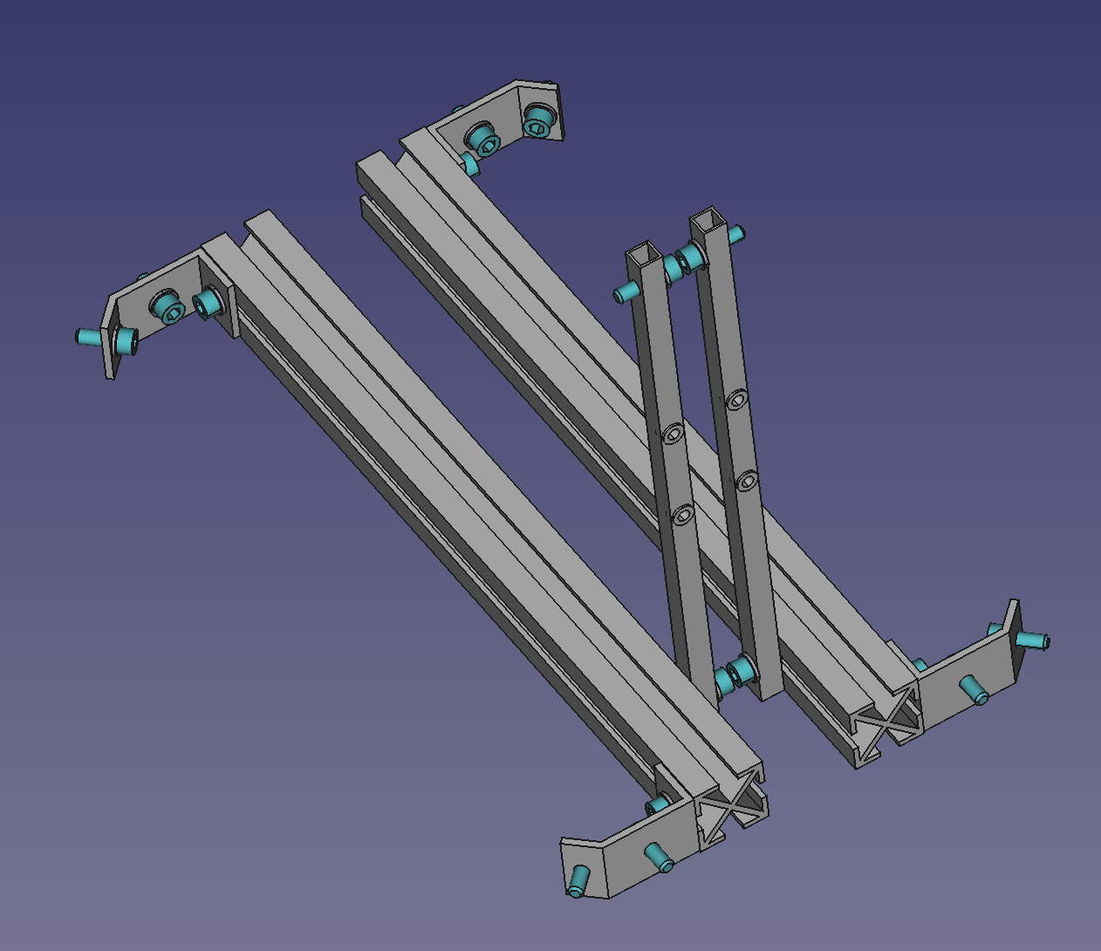
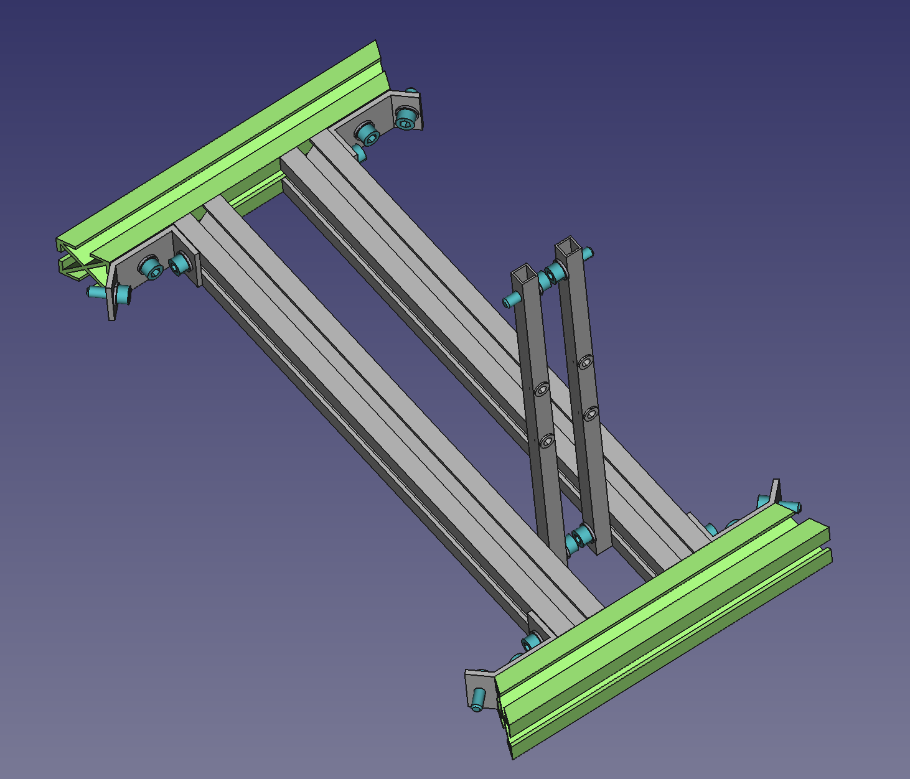
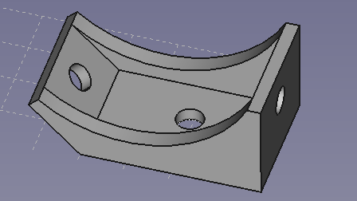
Set B
Number of units to assemble: 1
Insert 2 x M6 T-Nut in
top groove (batt)
Insert 2 x M5 T-Nuts
in ext. groove (cover)
2
Insert 1 x M6 T-Nut in
ext. groove (RFID)
Insert 3 x M6 T-Nut in
top groove (batt)
2 x M6 inner L-Nuts in
top groove (mid chassis)
4
2
3
1
Insert 1 x M5 T-Nuts in
top groove (drive)
1
3
Insert 3 x M6 T-Nut in
top groove (batt)
Insert 2 x M6 T-Nut in
bottom groove (axels)
2
Insert 1 x M6 T-Nut in
ext. groove (RFID)
Insert 2 x M6 T-Nut in
bottom groove (axels)
4
2
Insert 1 x M5 T-Nuts in
top groove (drive)
Insert 2 x M5 T-Nuts in
ext. groove (cover)
# | Part Num. | Part Name | Notes
1 | P0155 | 30x30 339 mm profile flat cut
2 | P0016 | 135deg_small_braket M6 3holes | Use Screw_M6x14_ISO4762 with M6 washers and T-Nuts
3 | P0215 | Alu Profile square 10x10x1 259mm with holes | Insert threaded rivet M5 and use Screw_M6x20_ISO4762 with M6 washers and T-Nuts
4 | P0165 | 30x30 138mm profile 22,5deg cut | Use Screw_M6x14_ISO4762 with M6 washers and T-Nuts

Slide 5
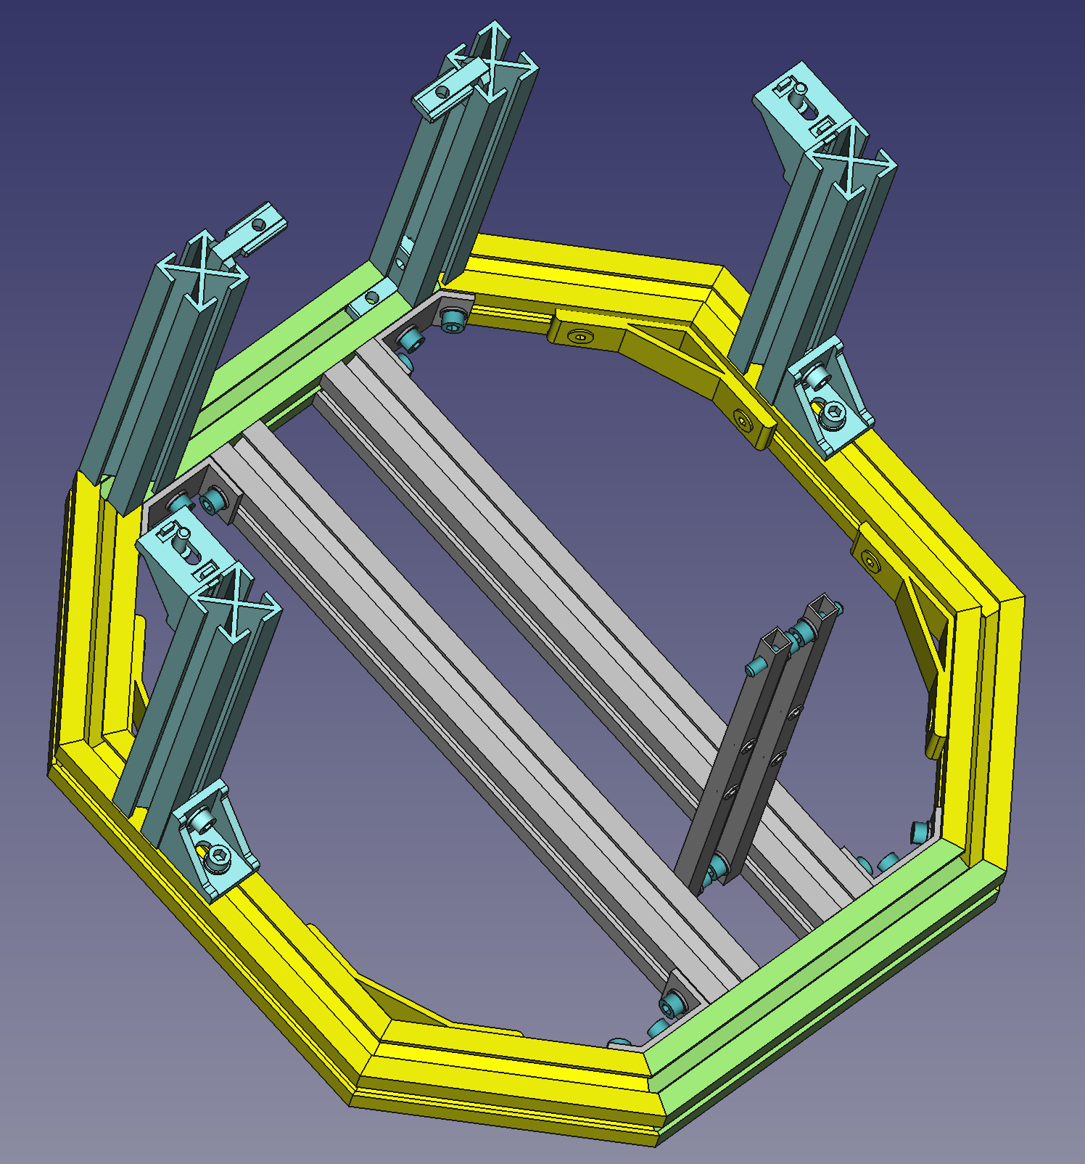
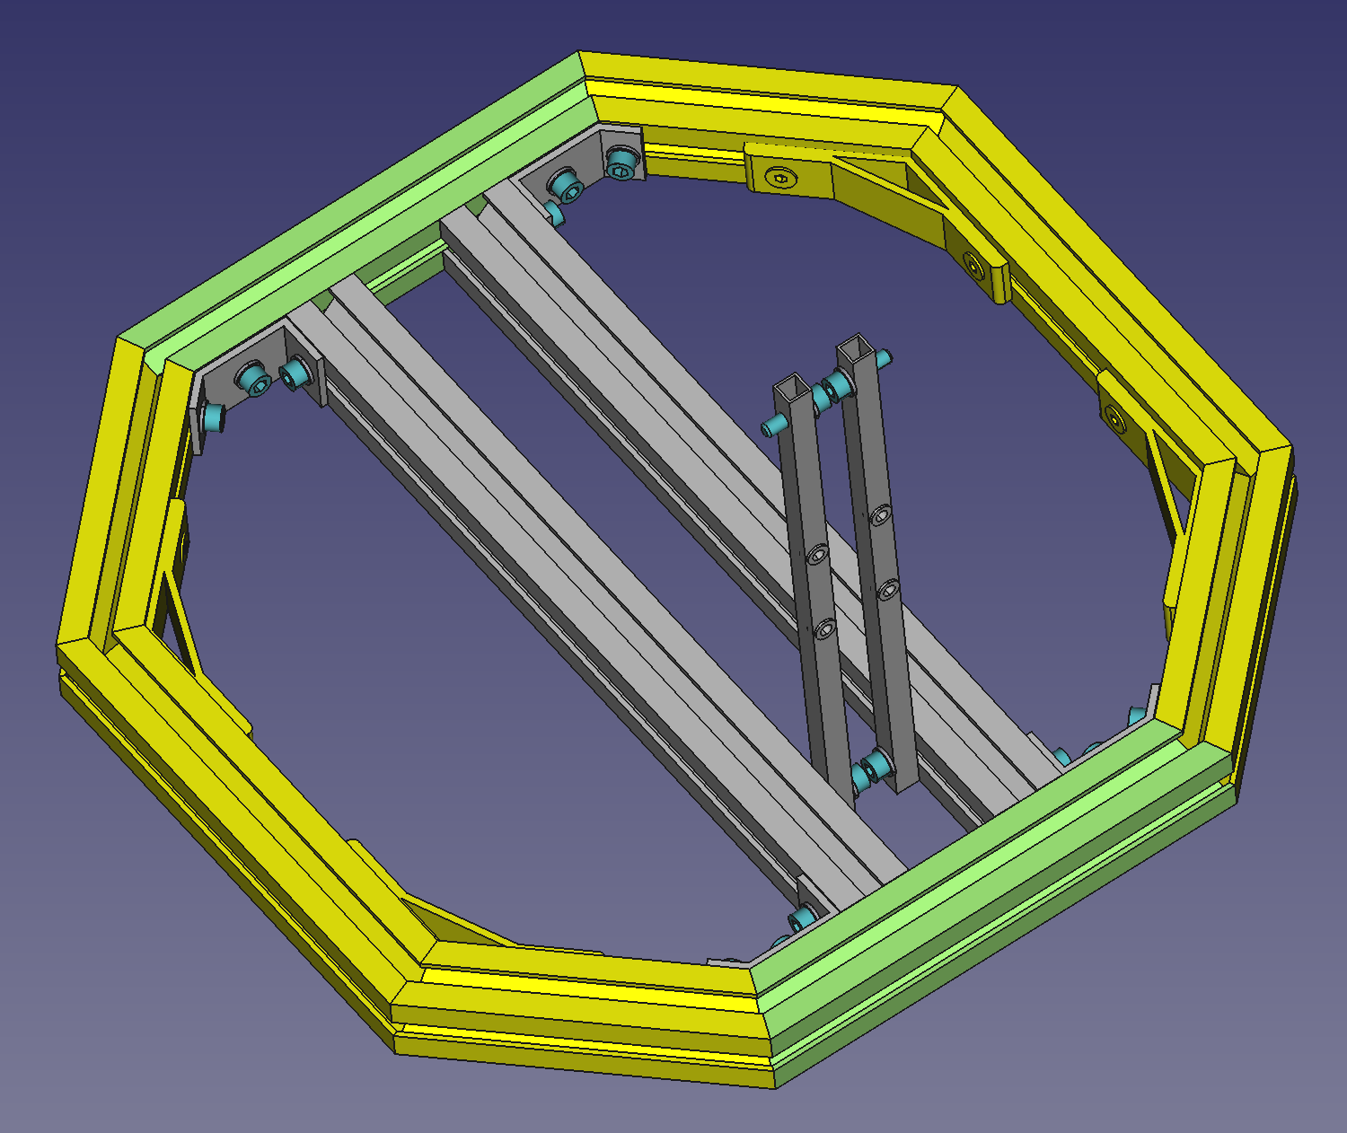
Insert 1 x M6 T-Nut in
int. groove (motor top)
Set A
3
3
2
1
1
1
3
2
Insert 1 x M6 T-Nut in
int. groove (motor top)
Insert 2 x M6 T-Nut in
front groove (laser beam)
2
Set B
1
# | Part Num. | Part Name | Notes
1 | P0170 | 30x30_200mm profile flat cut
2 | P0021 | 90 degree bracket | Use Screw_M6x14_ISO4762 with M6 washers and T-Nuts
3 | P0070 | 30x30 inner corner L nut | Use Screws for inner corner L nut
Insert 2 x M6 T-Nut in
front groove (laser beam)
2

Slide 6
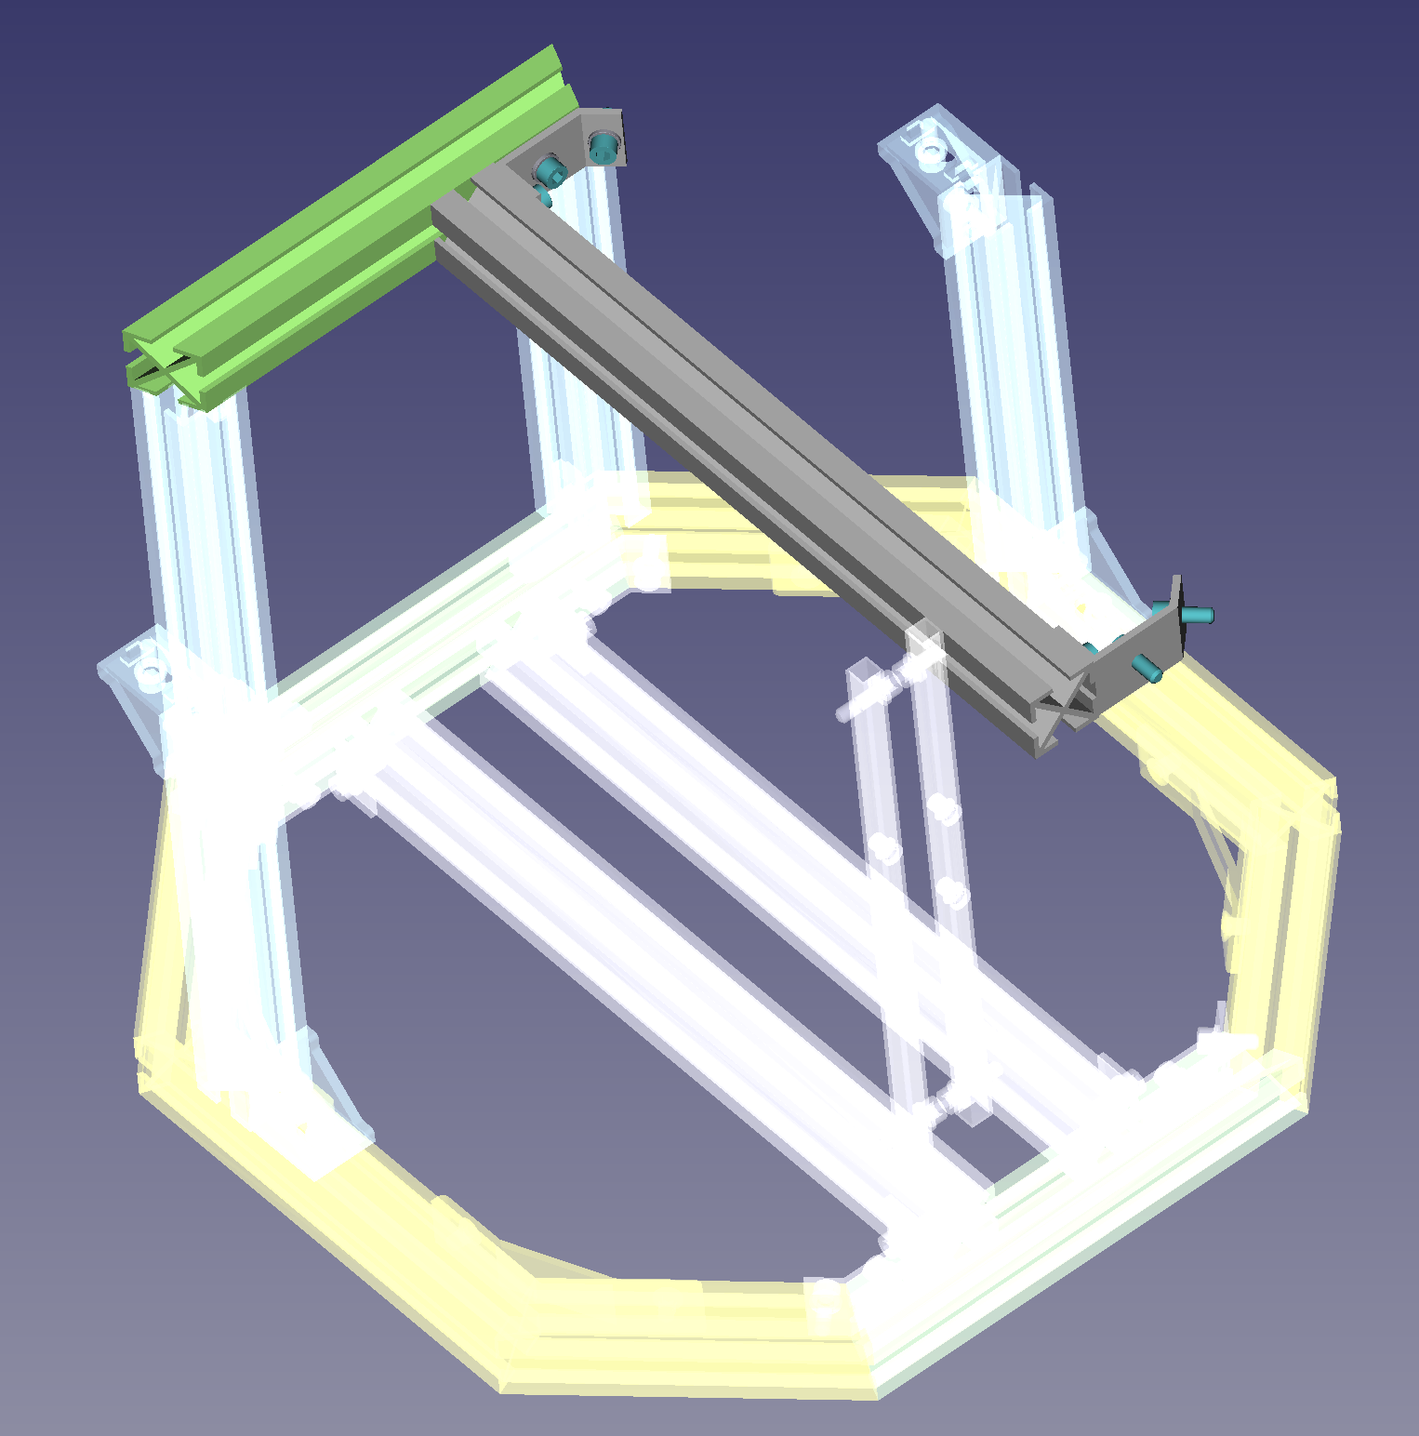
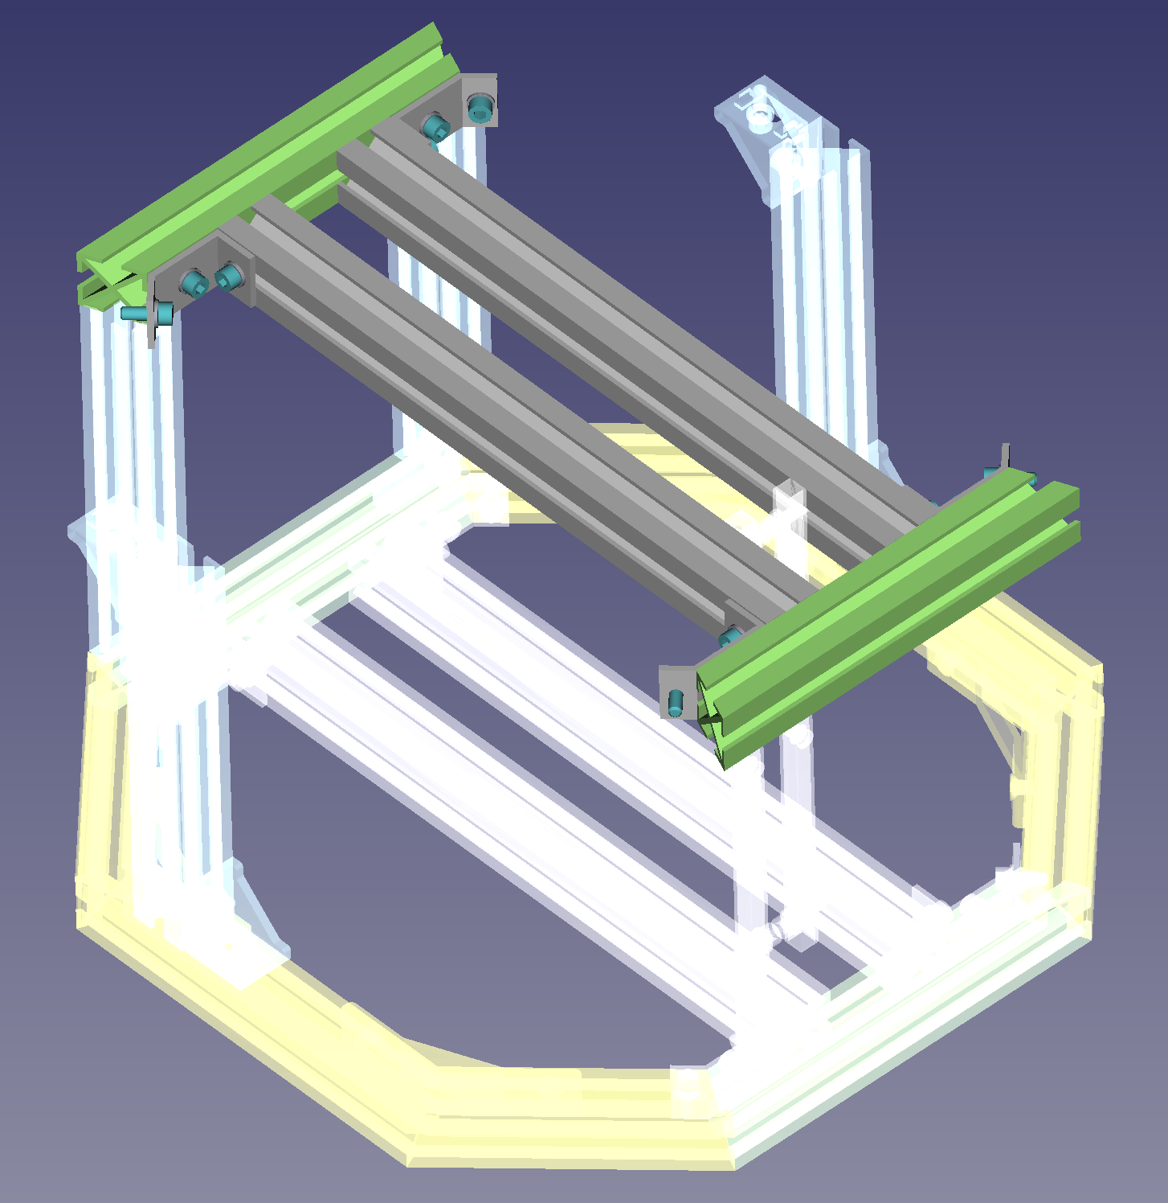
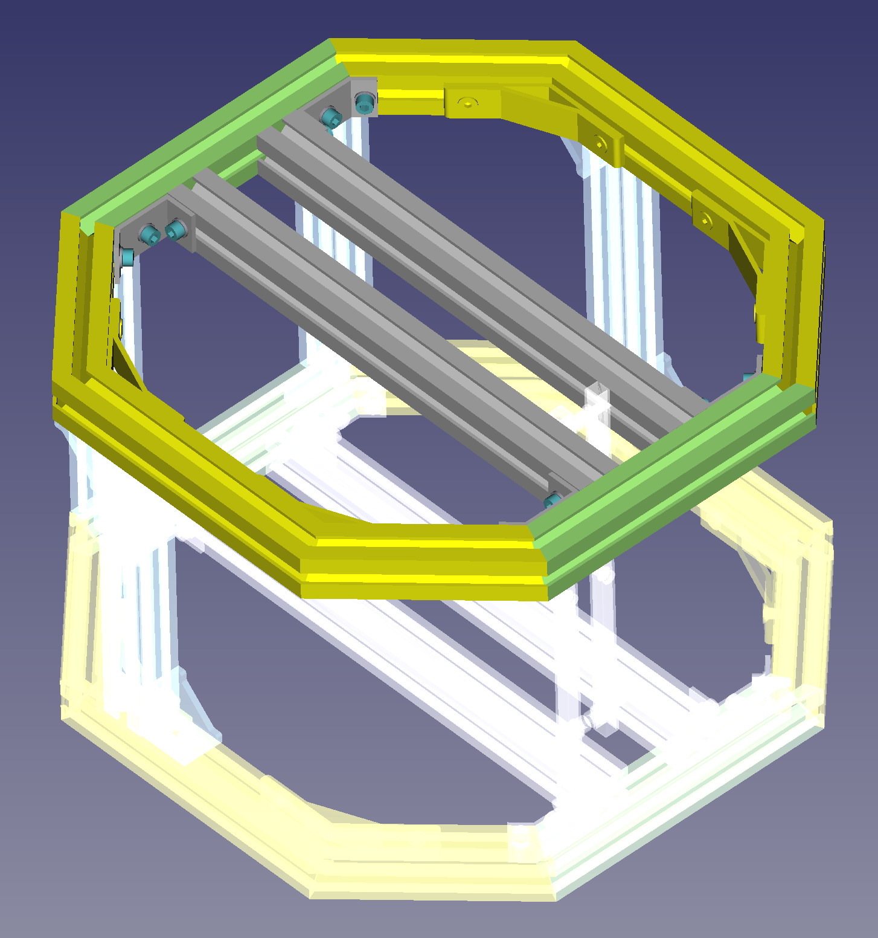
Insert 2 x M6 inner L-Nuts in
bottom groove (mid chassis)
Insert 2 x M5 T-Nuts
in top groove (cover)
Insert 2 x M5 T-Nuts
in ext. groove (cover)
Set A
3
2
Insert 2 x M6 T-Nuts in
ext. groove (laser supp)
1
Insert 2 x M5 T-Nut
in bottom groove (PLC)
2
2
1
3
Insert 2 x M6 T-Nuts in
ext. groove (laser supp)
2
Insert 2 x M5 T-Nuts
in ext. groove (cover)
Insert 2 x M5 T-Nuts
in top groove (cover)
# | Part Num. | Part Name | Notes
1 | P0155 | 30x30 339 mm profile flat cut
2 | P0016 | 135deg_small_braket M6 3holes | Use Screw_M6x14_ISO4762 with M6 washers and T-Nuts
3 | P0165 | 30x30 138mm profile 22,5deg cut | Use Screw_M6x14_ISO4762 with M6 washers and T-Nuts

Slide 7
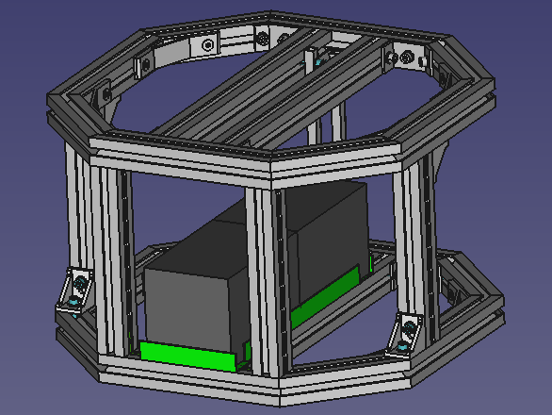
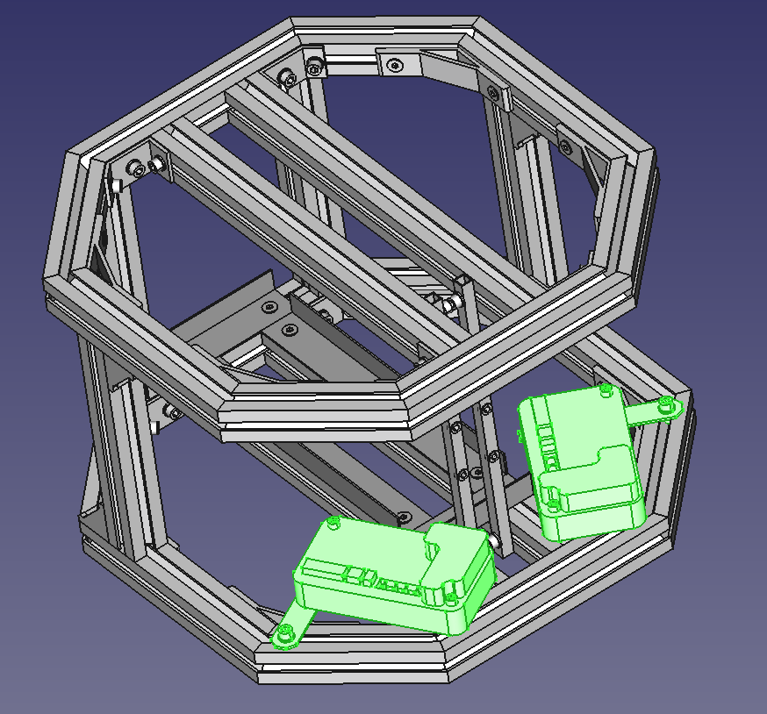
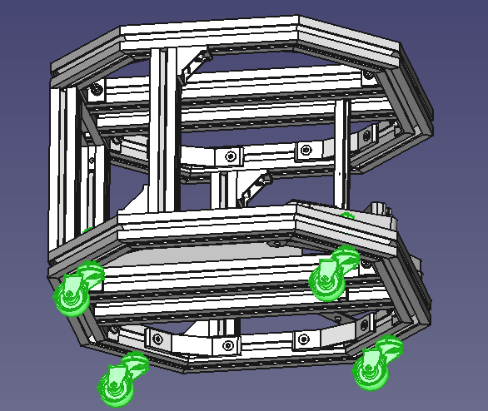
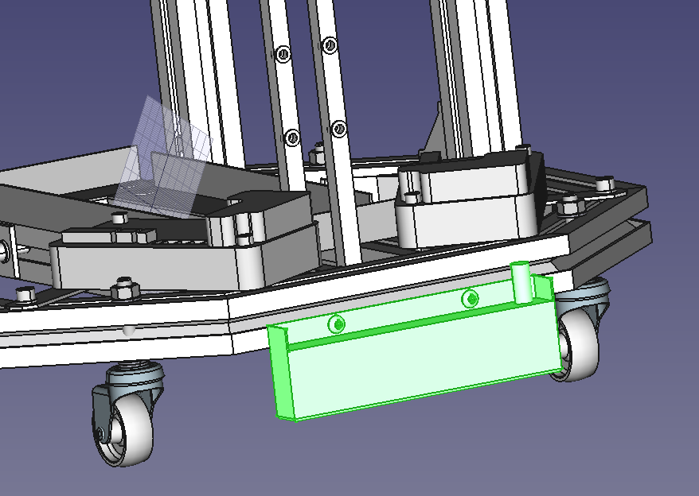
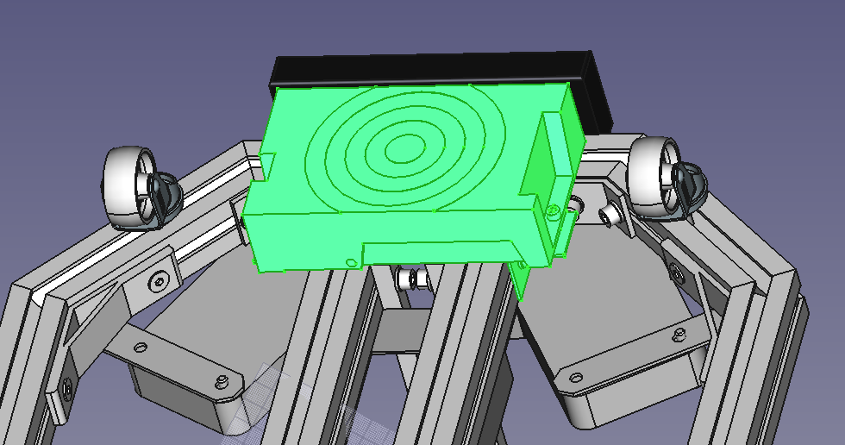
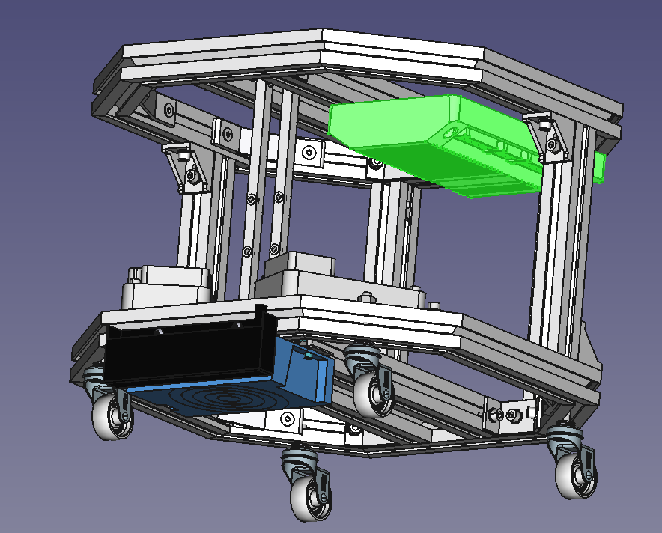
Assembly Part 2
-Batteries support
-Drives set
-Caster wheels set
-Magnetic Sensor set
-RFID Set
-PLC Set

Slide 8
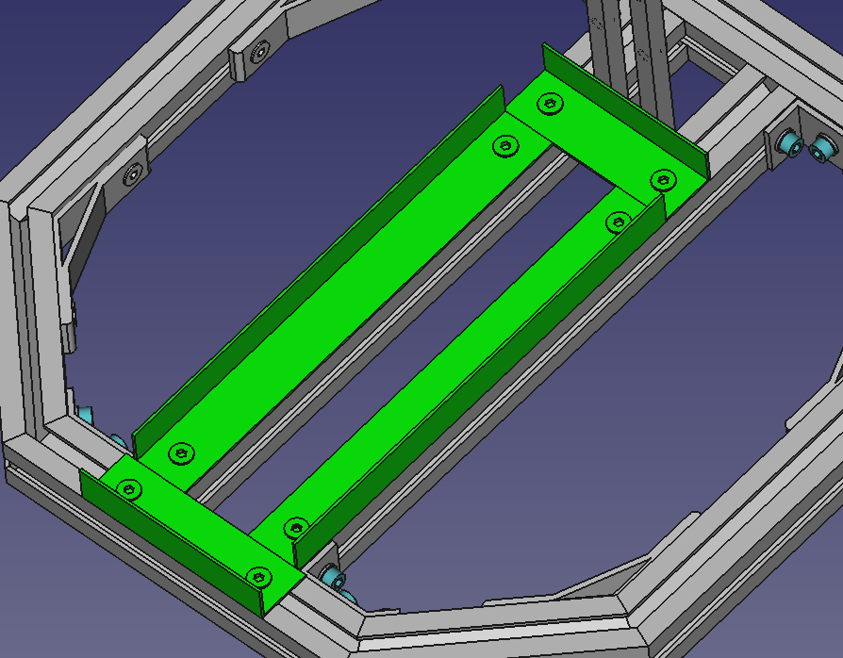
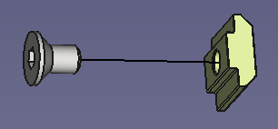
Battery Support
1
2
2
1
# | Part Num. | Part Name | Notes
1 | P0230 | Aluminum Profile L shape 30x20x1,5 98mm | Use Screw_M6x14_CS with M6 T-Nuts
2 | P0220 | Aluminum Profile L shape 30x20x1,5 250mm | Use Screw_M6x14_CS with M6 T-Nuts

Slide 9
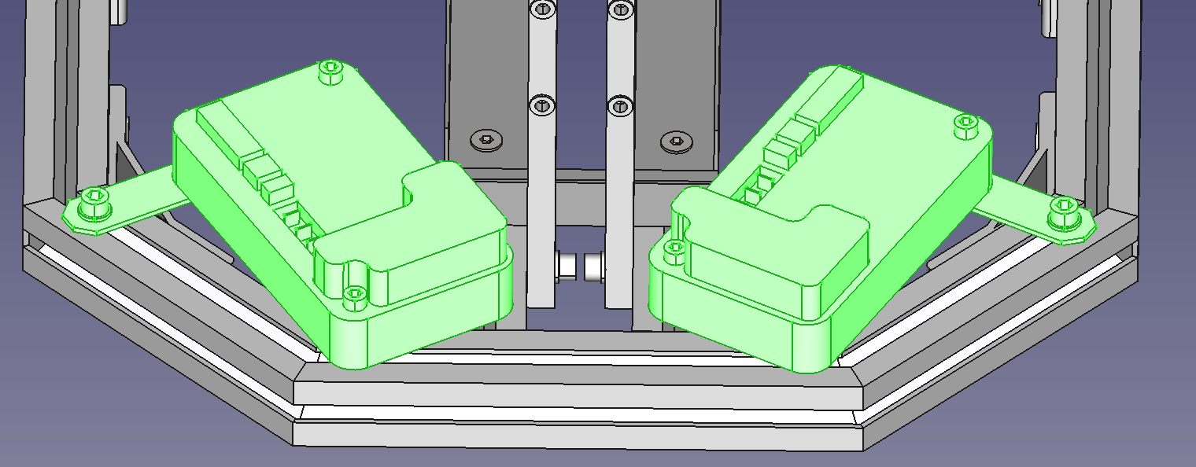
Driver set
3
3
1
2
# | Part Num. | Part Name | Notes
1 | P0415 | Drive support | Threaded rivet M5 in end hole, Screw_M6x14_ISO4762 with M6 washers and T-Nuts in first hole
2 | P0415 | Drive support | Threaded rivet M5 in mid hole, Screw_M6x14_ISO4762 with M6 washers and T-Nuts in first hole
3 | P0535 | PG Driver | Screw_M5x30_ISO4762

Slide 10
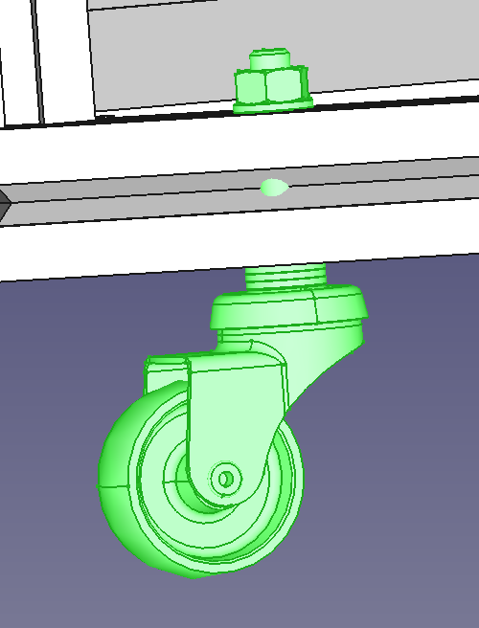
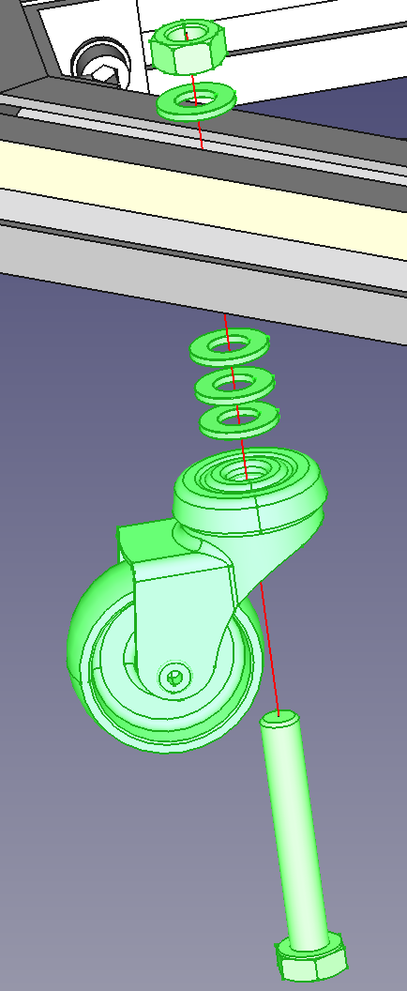
Caster wheels set
P0420 | Caster wheels ALEX SERIE B-BP 3-0006
Use Screw_M8x50 HEX HEAD with three M8 washers as spacers (about 5mm in total between caster wheel and frame) and one M8 washer + Nut to fix it to the frame

Slide 11
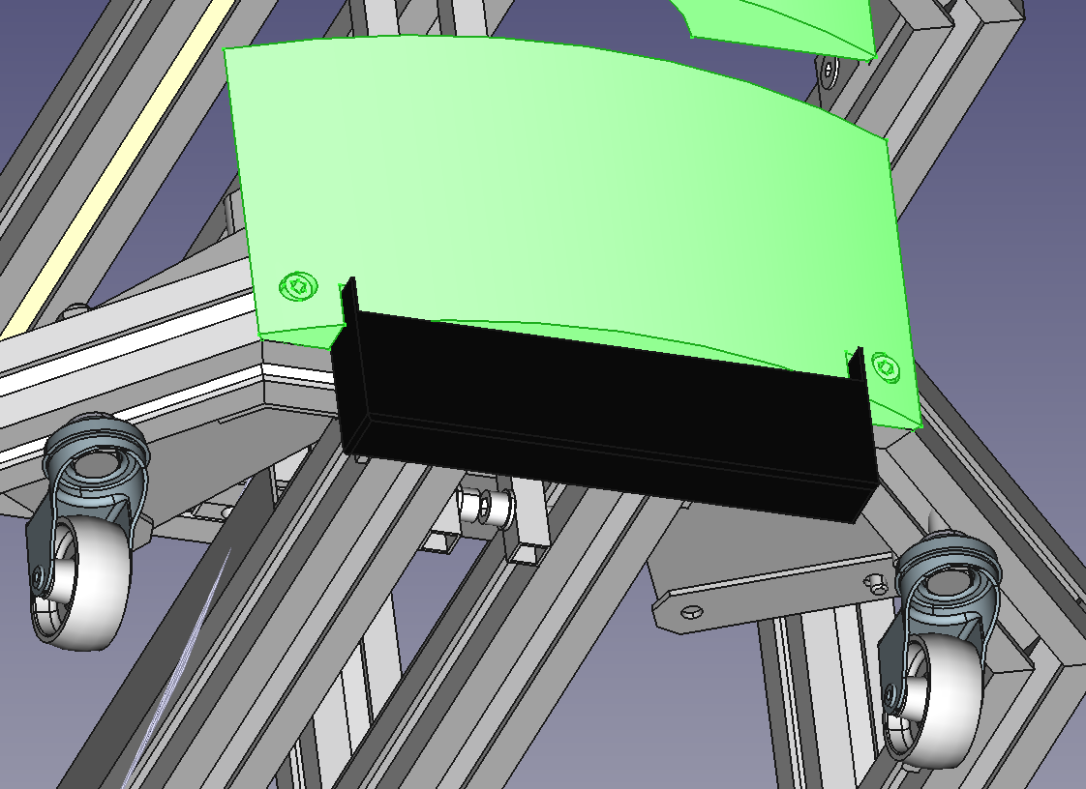
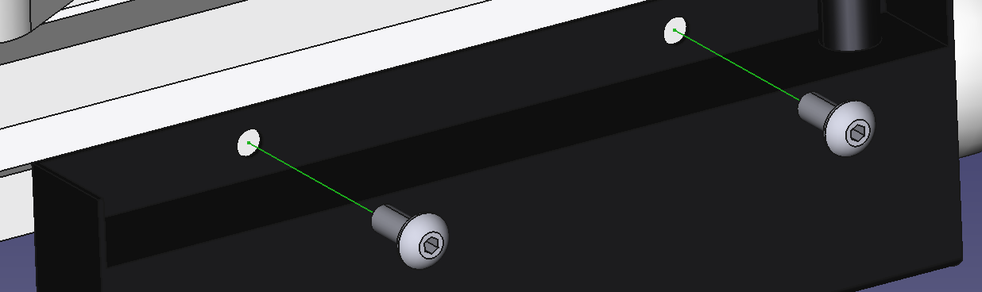
Magnetic Sensor set
1. Put the sensor on the beam as shown in left figure using P0310 part to centre the sensor as shown in right figure
2. Mark the 2 holes of the sensor on the beam
3. Make two 4,5mm holes on them and thread them to get M5 threaded holes
4. Use Screw_M5x12 BHCS to fix the sensor to the beam

Slide 12
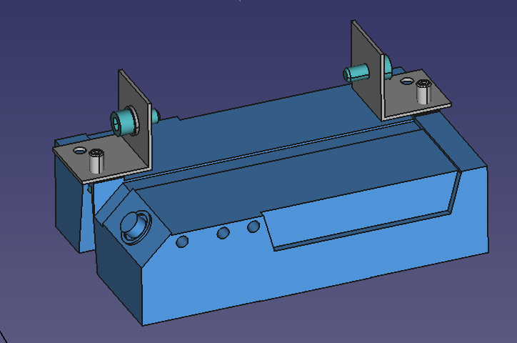
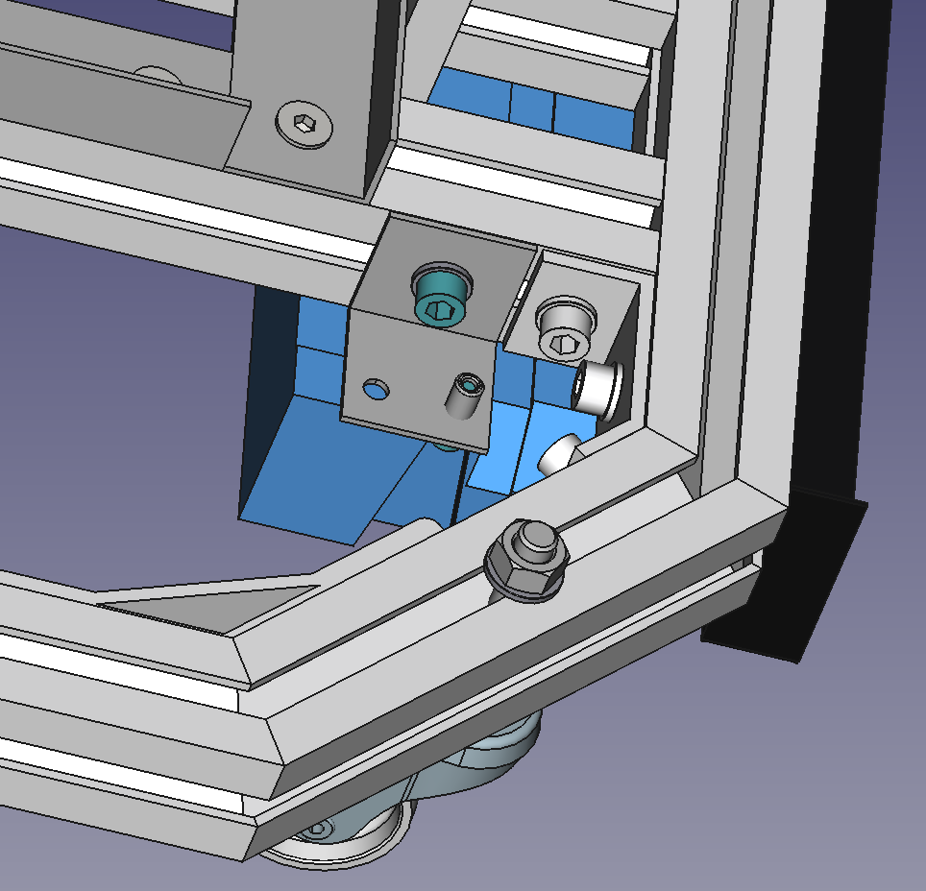
RFID Set
Use P0425 (Bracket RFID). There are two.
Attach brackets to RFID sensor using Screw_M4x12_ISO4762
Attach RFID Set (sensor+brackets) to frame using Screw_M6x14_ISO4762, M6 washer and T-Nut

Slide 13
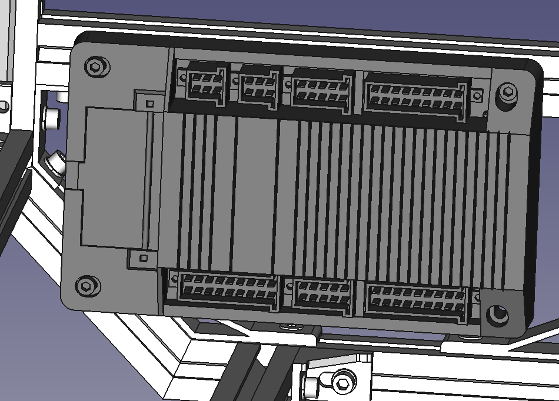
PLC Set
PLC is attacher to inner part of “Chassis Top” by using three Screw_M5x30_ISO4762 with M5 T-Nut

Slide 14
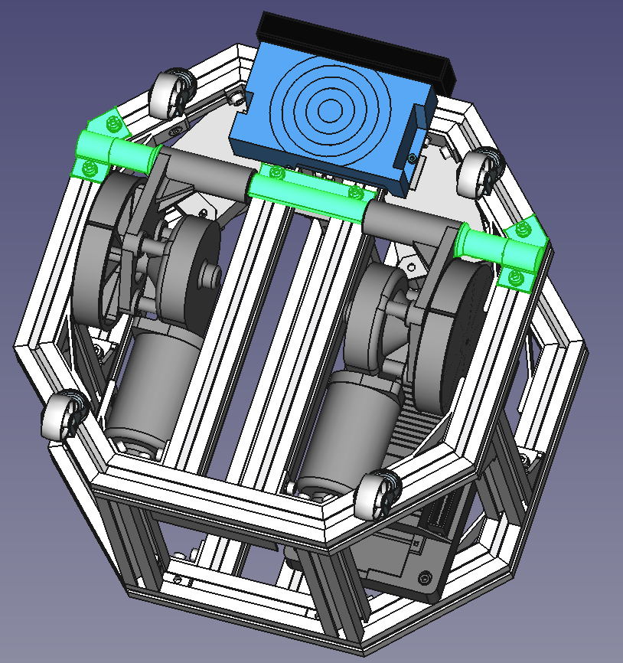
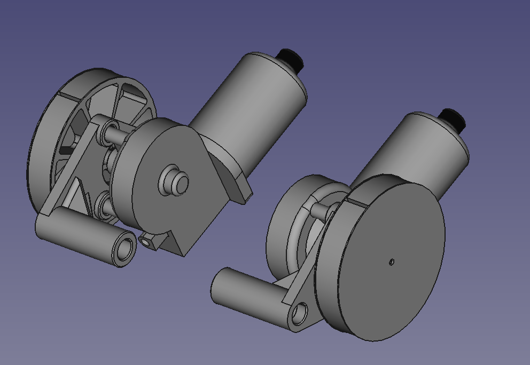
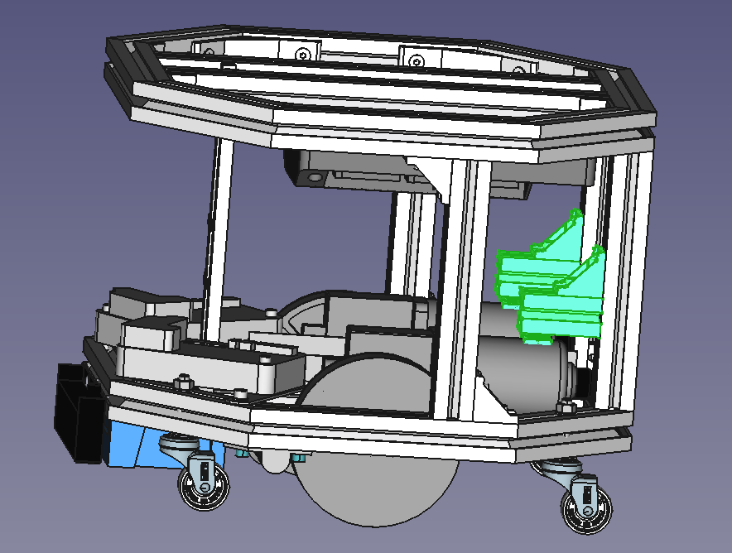
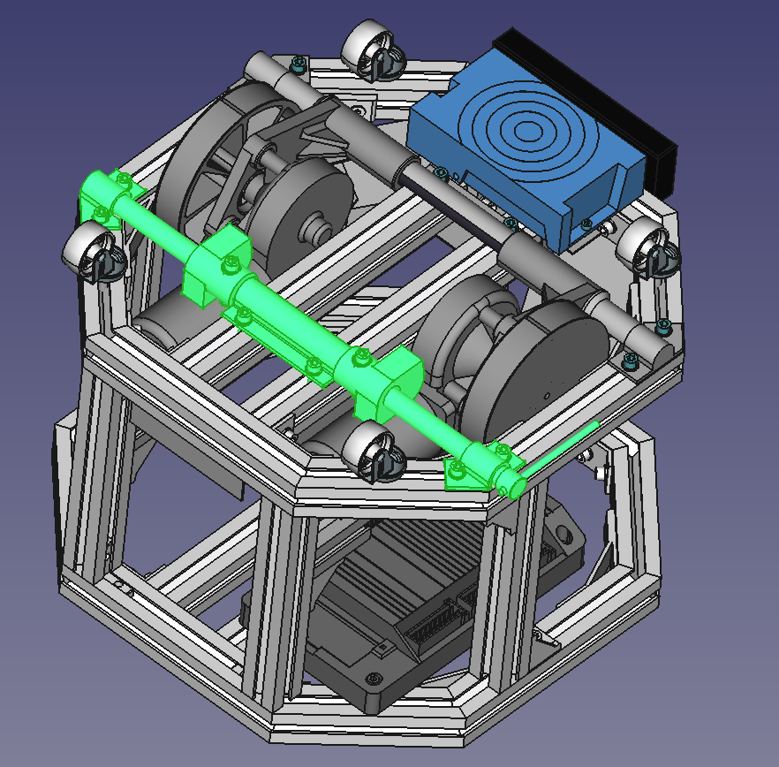
Assembly Part 3
-Motors+Encoders
-Balancing axel set
-Set limit motors Top
-Clutch set

Slide 15
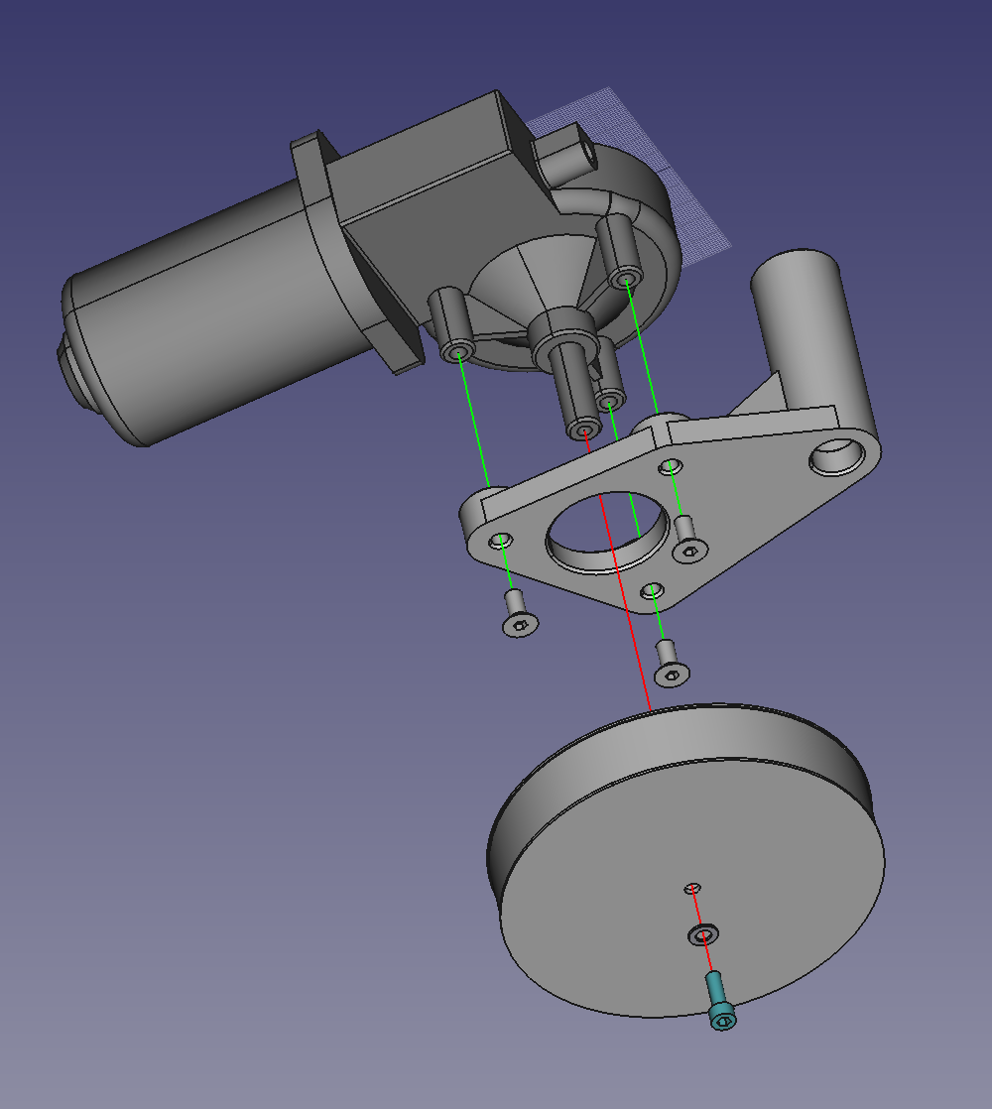
Motors+Encoders
6
3
2
4
3
1
5
6
4
6
1
# | Part Num. | Part Name | Notes
1 | P0455 | Motor_Nidec_404_385_ right side
2 | P0460 | Motor_Nidec_404_385_left side
3 | P0470 | Encoder | Attach to motors
4 | P0290 | AGV_Soporte_motor_D | Use Screw_M6x14_CS (countersunk)
5 | P0295 | AGV_Soporte_motor_I | Use Screw_M6x14_CS (countersunk)
6 | P0300 | AGV_Rueda | Put rubber band 22mm wide (P0385). Use Screw_M5x16_ISO4762 with M5 washer

Slide 16
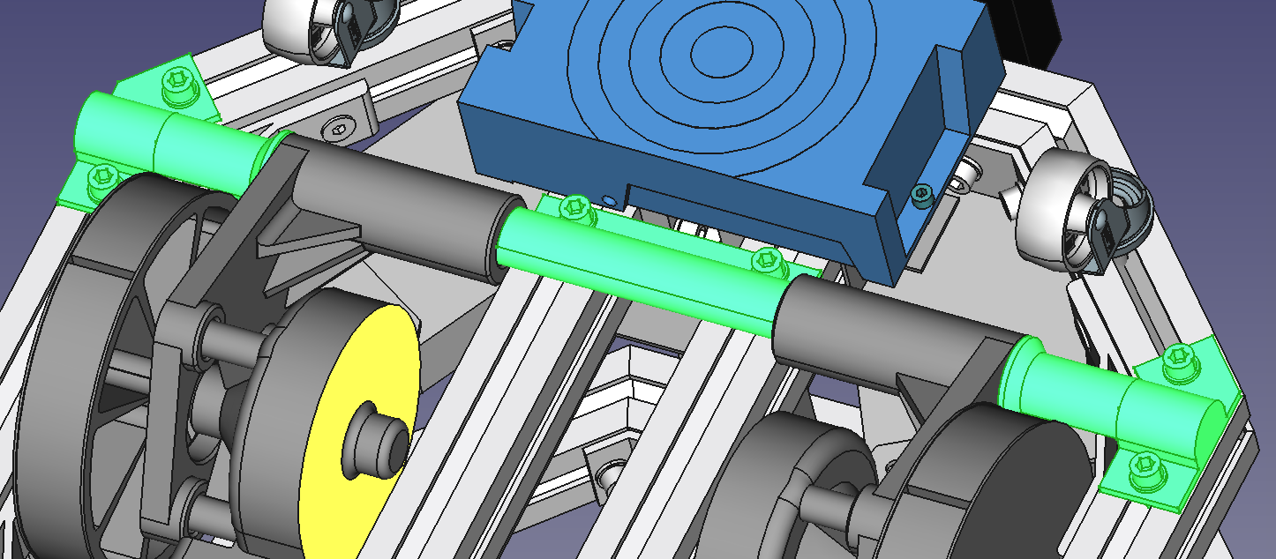
Balancing axel set
3
4
1
2
# | Part Num. | Part Name | Notes
1 | P0435 | Balancing axel (tube 390x16mm)
2 | P0250 | 16mm axel corner clamp side a long | Use Screw_M6x14_ISO4762 with M6 washers and T-Nuts
3 | P0255 | 16mm axel corner clamp side b long | Use Screw_M6x14_ISO4762 with M6 washers and T-Nuts
4 | P0260 | Axel clamp | Use Screw_M6x14_ISO4762 with M6 washers and T-Nuts

Slide 17
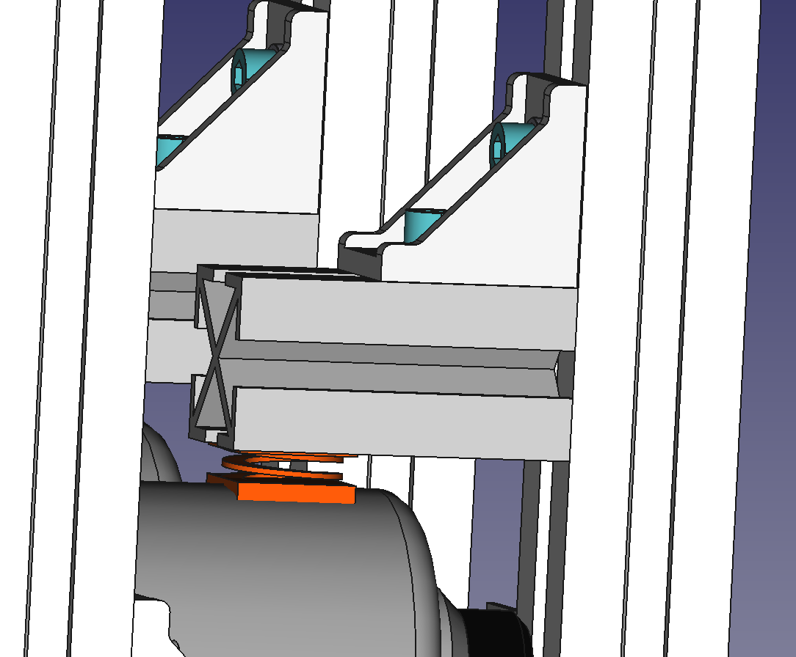
Set limit motors Top
2
1
3
# | Part Num. | Part Name | Notes
1 | P0175 | 30x30_60mm profile flat cut
2 | P0021 | 90 degree bracket | Use Screw_M6x14_ISO4762 with M6 washers and T-Nuts
3 | P0446 | Spring

Slide 18
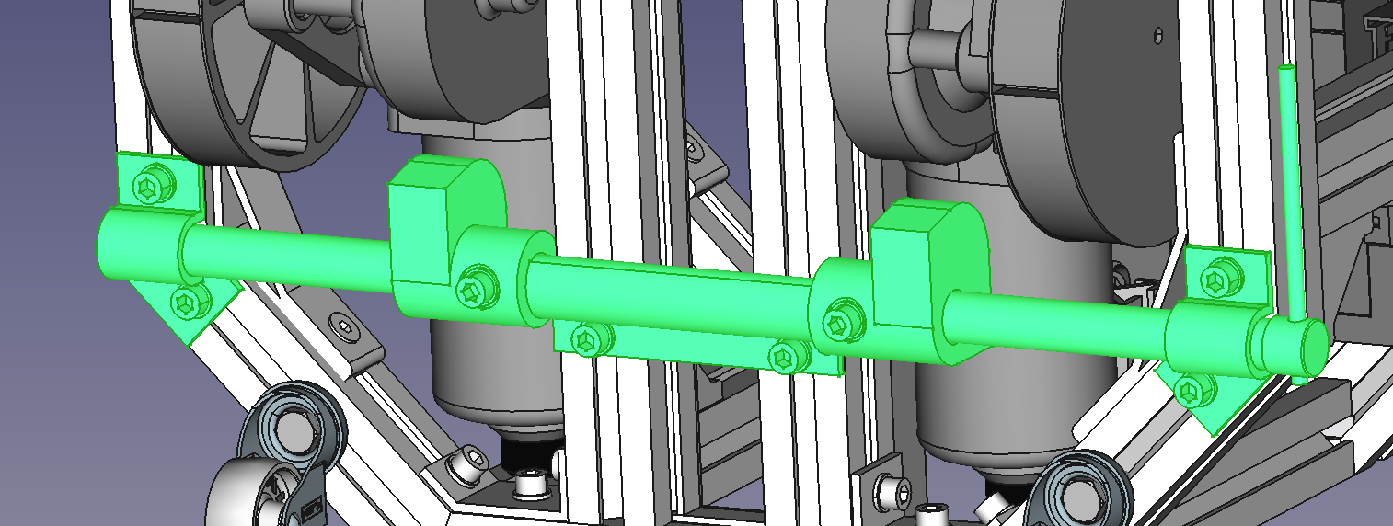
Clutch set
8
6
3
1
4
7
6
2
5
# | Part Num. | Part Name | Notes
1 | P0430 | Clutch axel (tube 410x16mm)
2 | P0260 | Axel clamp | Use Screw_M6x14_ISO4762 with M6 washers and T-Nuts
3 | P0265 | Clutch-cam A | Use Screw_M6x35_ISO4762 with 2 x M6 washers and Nut
4 | P0270 | Clutch-cam B | Use Screw_M6x35_ISO4762 with 2 x M6 washers and Nut
5 | P0275 | Clutch axel cap
6 | P0280 | Clutch axel clamp A | Use Screw_M6x14_ISO4762 with M6 washers and T-Nuts
7 | P0285 | Clutch axel clamp B | Use Screw_M6x14_ISO4762 with M6 washers and T-Nuts
8 | P0390 | Clutch lever (100x5mm bar)

Slide 19
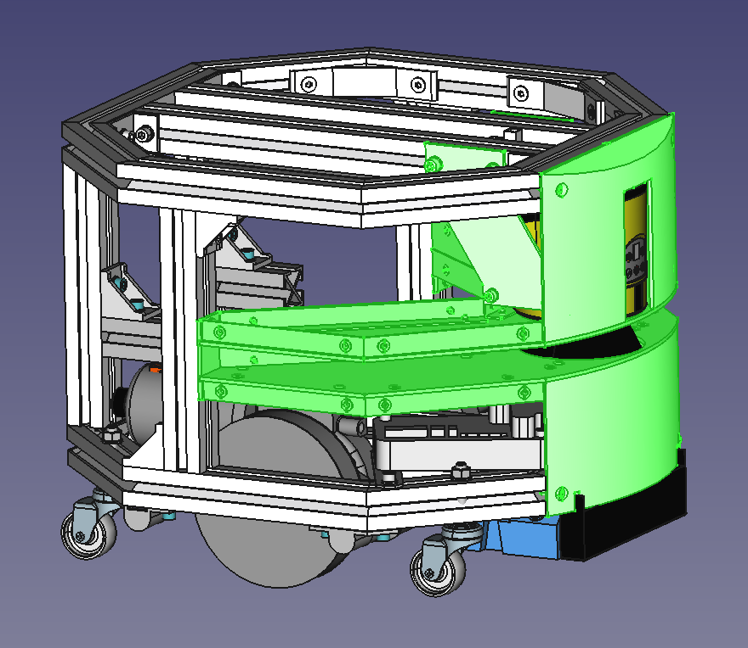
Assembly Part 4
-Laser beam area – Inside
-Laser beam area – Bottom
-Laser beam area – Top
-Front Cover Set
-Laser Set

Slide 20
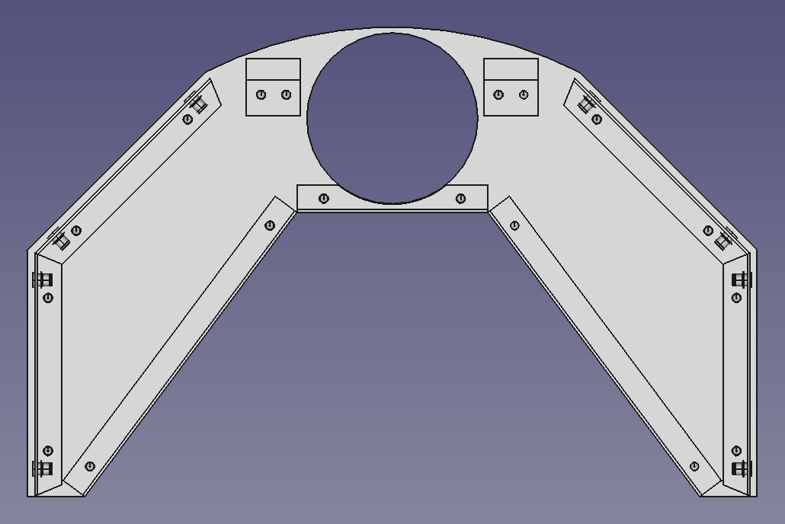
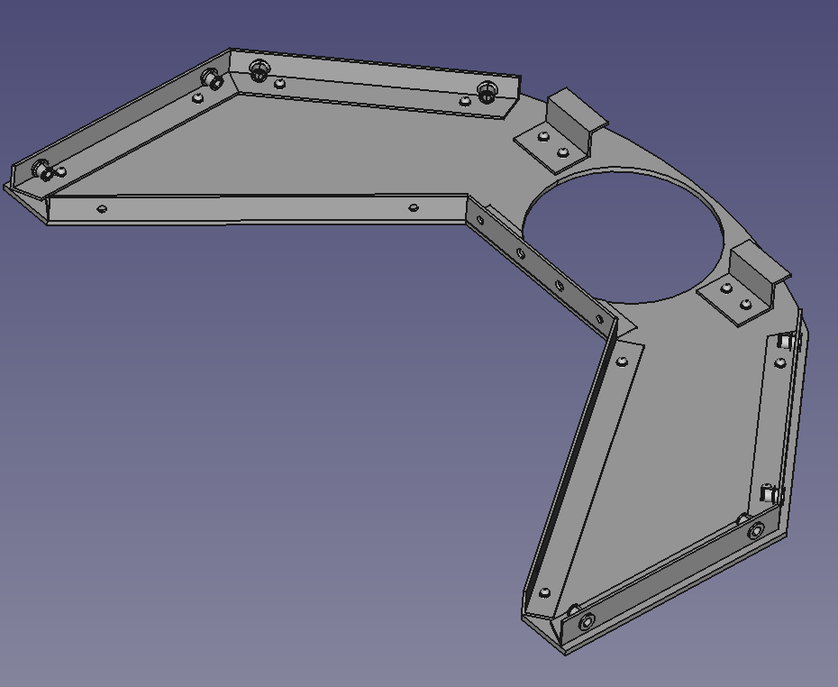
Laser beam area – Top
Cut all this part
4
4
4
3
3
6
1
5
5
2
2
# | Part Num. | Part Name | Notes
1 | P0375 | PVC 3mm piece: laser beam area sheet
2 | P0190 | Alu Profile L shape 15x15x1,5 135mm 22,5deg | Use 4,2mm aluminum rivets inserted from P0375 side
3 | P0195 | Alu Profile L shape 15x15x1,5 137,5mm 22,5deg | Use 4,2mm aluminum rivets inserted from P0375 side
4 | P0411 | Bracket front laser | Use 4,2mm aluminum rivets inserted from P0375 side
5 | P0200 | Alu Profile L shape 15x15x1,5 197mm | Use 4,2mm aluminum rivets inserted from P0375 side
6 | P0185 | Alu Profile L shape 15x15x1,5 106mm | Use 4,2mm aluminum rivets inserted from P0375 side

Slide 21
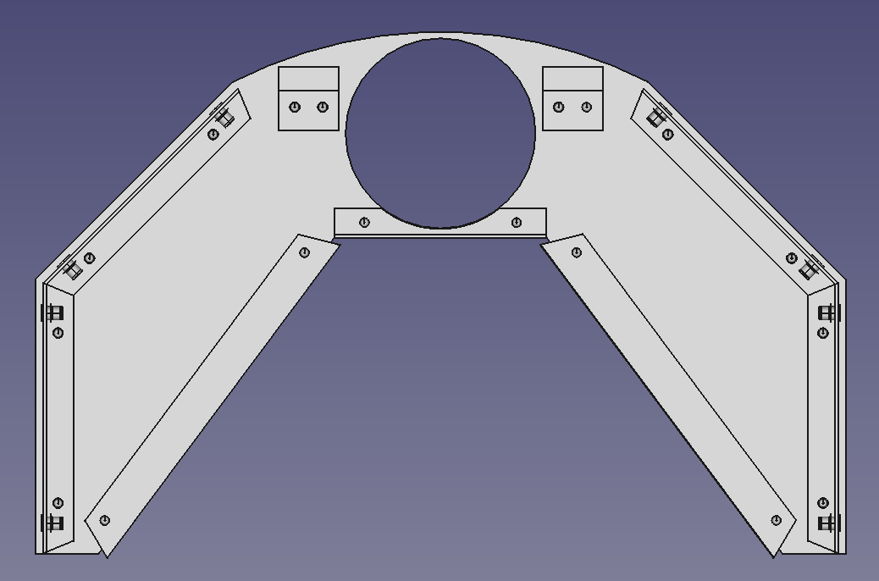
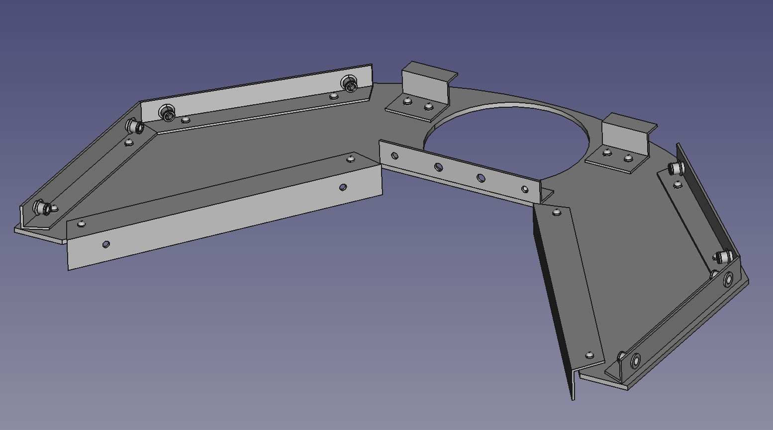
Laser beam area – Bottom
Cut all this part
4
4
3
3
6
1
5
5
2
2
Note the orientation of L-profiles P0205 in opposite to the rest
# | Part Num. | Part Name | Notes
1 | P0375 | PVC 3mm piece: laser beam area sheet
2 | P0190 | Alu Profile L shape 15x15x1,5 135mm 22,5deg | Use 4,2mm aluminum rivets inserted from P0375 side
3 | P0195 | Alu Profile L shape 15x15x1,5 137,5mm 22,5deg | Use 4,2mm aluminum rivets inserted from P0375 side
4 | P0411 | Bracket front laser | Use 4,2mm aluminum rivets inserted from P0375 side
5 | P0205 | Aluminum Profile L shape 20x20x1,5 195mm 22,5deg | Use 4,2mm aluminum rivets inserted from P0375 side
6 | P0185 | Alu Profile L shape 15x15x1,5 106mm | Use 4,2mm aluminum rivets inserted from P0375 side

Slide 22
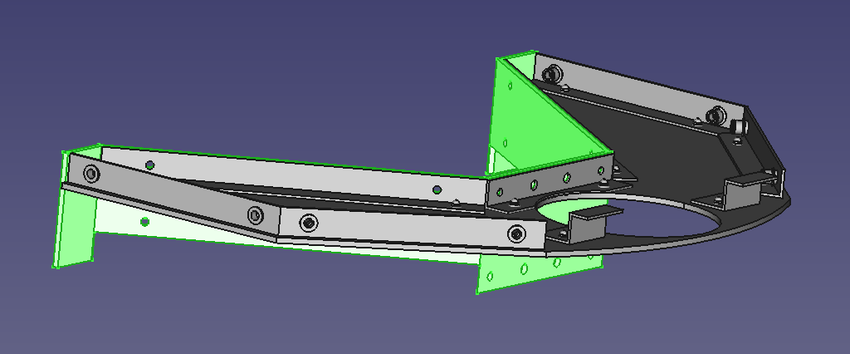
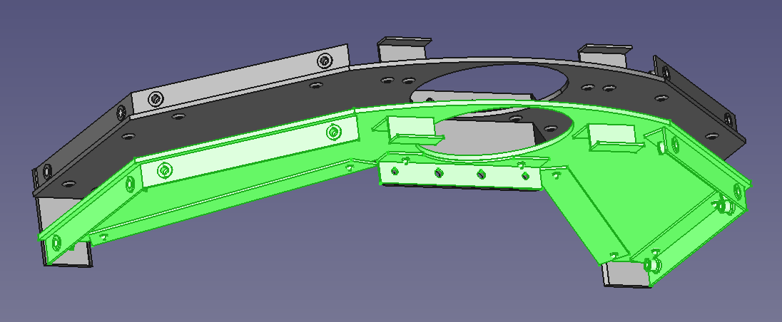
Join the three parts
Join Laser beam area – Top with Laser beam area – Inside using 4,2mm aluminum rivets from the side of Laser beam area – Inside
Join Laser beam area – Bottom with Laser beam area – Inside using 4,2mm aluminum rivets from the side of Laser beam area – Inside

Slide 23
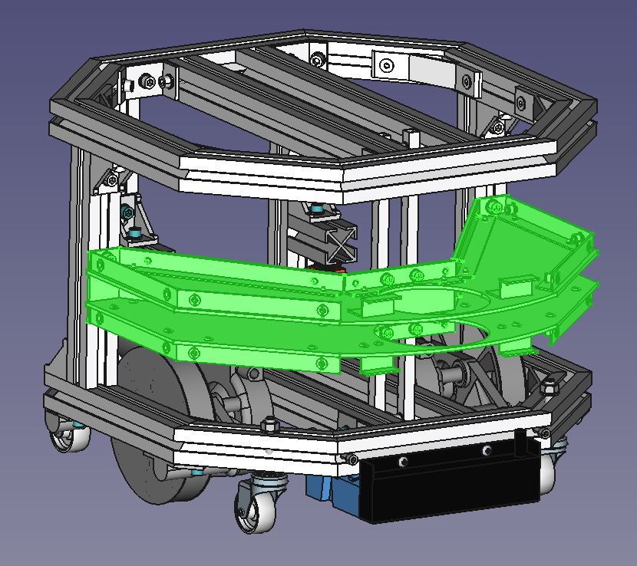
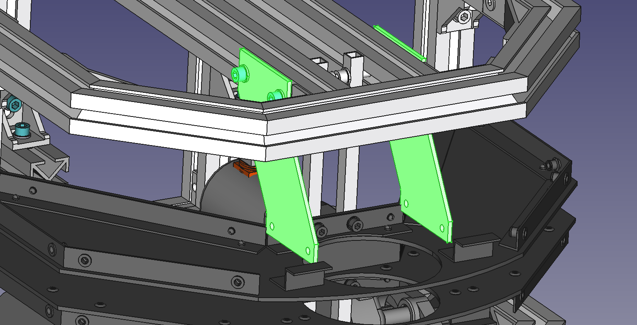
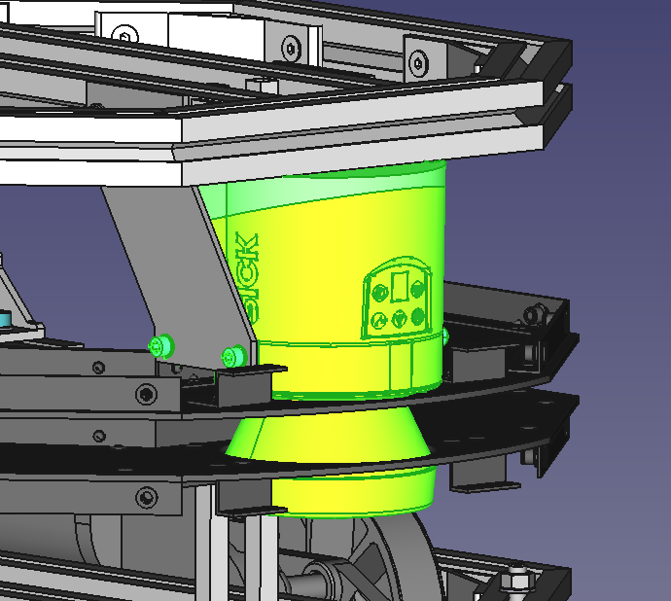
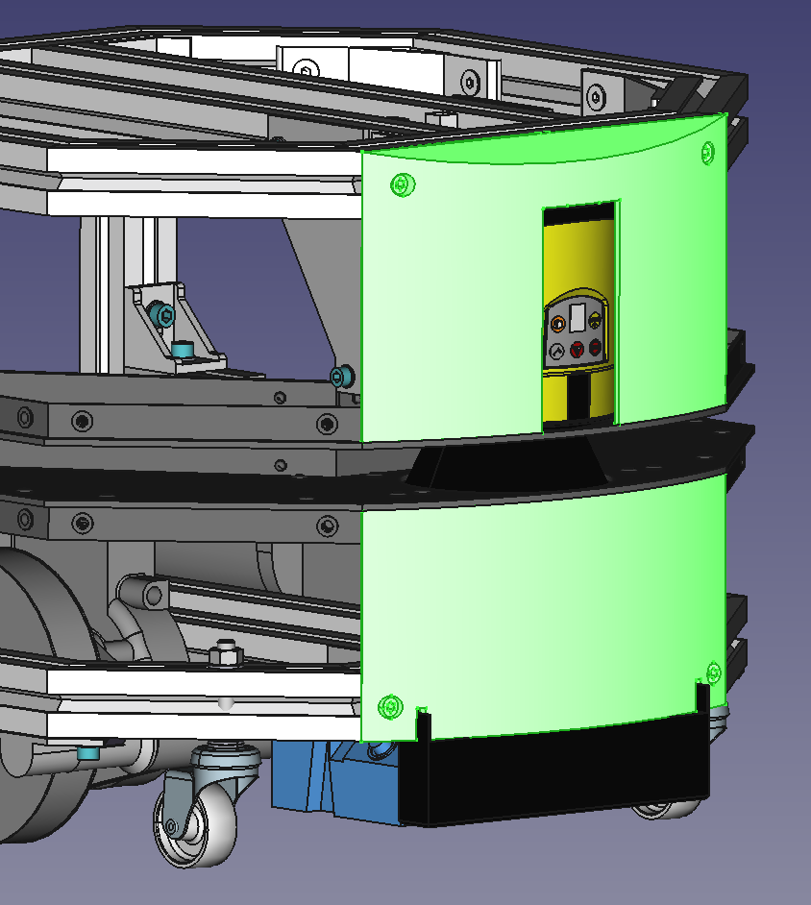
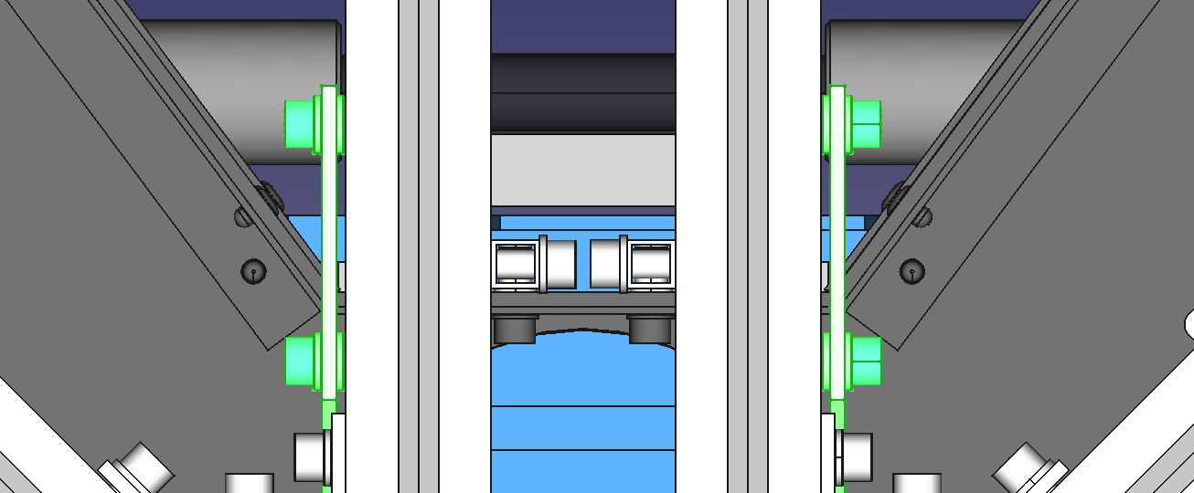

Laser beam area block + Laser Set + Front Cover Set
Install:
P0305 Front Top Cover
P0310 - Front Bottom Cover
with Screw_M5x12_ISO4762 and M5 T-Nut
Install Laser Beam Area Block (assembled previously) with:
4 Screw_M5x12_CS in centre
4 Screw_M6x14_ISO4762 in sides with M6 T-nut
All with washer.
Install P0325 Laser Support with 4 Screw_M6x14_ISO4762 + M6 washers at both sides of the piece: One in the side of the screw head and another between the Laser Support and the aluminum beam.
Use M6 T-Nuts too.
Insert P0465 Sick s300 safety laser through the front and attach to Laser support sheets with Screw_M5x12_ISO4762 + M5 washers

Slide 24

Assembly Part 5
-Flexisoft Set
-Back Cover Set

Slide 25



Flexisoft Set
Install P0445 DIN Rail 120mm
using Screw_M6x14_ISO4762 + M6 washers from the Laser Support
Install P0450 Flexisoft modules
It may be necessary to put another screw at the bottom of the DIN rail to prevent the Flexisoft modules move out of it.
Note the position of the Flexisoft modules.

Slide 26



Back Cover Set - Top
# | Part Num. | Part Name | Notes
1 | P0315 | Back top Cover
2 | P0316 | RPiBox | Use Screw_M3x12_CS
3 | P0505 | Raspberry Pi 3B | Assemble with P0510 following P0510 manual
4 | P0510 | 7 inch touch screen | Assemble with P0505 following P0510 manual. Use M3x5 BHCS to attach to P0315

Slide 27


Back Cover Set – Bottom and full Back Cover Set assembly to AGV
1
3
4
2
Use Screw_M5x12_ISO4762 and M5 T-Nut
# | Part Num. | Part Name | Notes
1 | P0320 | Back bottom Cover
2 | P0490 | Emergency stop button 19mm
3 | P0495 | Momentary push button with white ring led 19mm
4 | P0500 | Battery capacity display

Slide 28

Assembly Part 6
-Top cover Set
-Sides cover Set

Slide 29


Top Cover Set – Bottom and full Back Cover Set assembly to AGV
1
1
4
2
2
4
7
6
7
6
5
3
3
5
# | Part Num. | Part Name | Notes
1 | P0340 | PVC 3mm piece: Top cover | Use Screw_M5x12_CS + M5 T-Nut
2 | P0370 | PVC 3mm piece: Front Side-Top Cover | Use Screw_M5x12_CS + M5 T-Nut
3 | P0345 | PVC 3mm piece: Front Side-Bottom Cover | Use Screw_M5x12_CS + M5 T-Nut
4 | P0360 | PVC 3mm piece: Lateral-Top Cover | Use Screw_M5x12_CS + M5 T-Nut
5 | P0365 | PVC 3mm piece: Lateral-Bottom Cover | Use Screw_M5x12_CS + M5 T-Nut
6 | P0350 | PVC 3mm piece: Lateral-Back Cover | Use Screw_M5x12_CS + M5 T-Nut
7 | P0355 | PVC 3mm piece: Back Side Cover | Use Screw_M5x12_CS + M5 T-Nut

